Slide 1
Defragment your hard drive with Windows

Slide 2
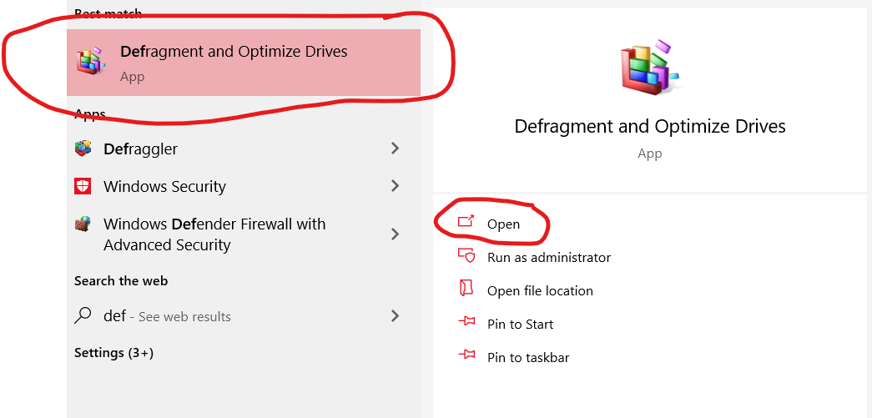
Open the defragmenter
Go down to the Windows search bar and type: “defragment,” open the option that says “Defragment and Optimize Drive”

Slide 3
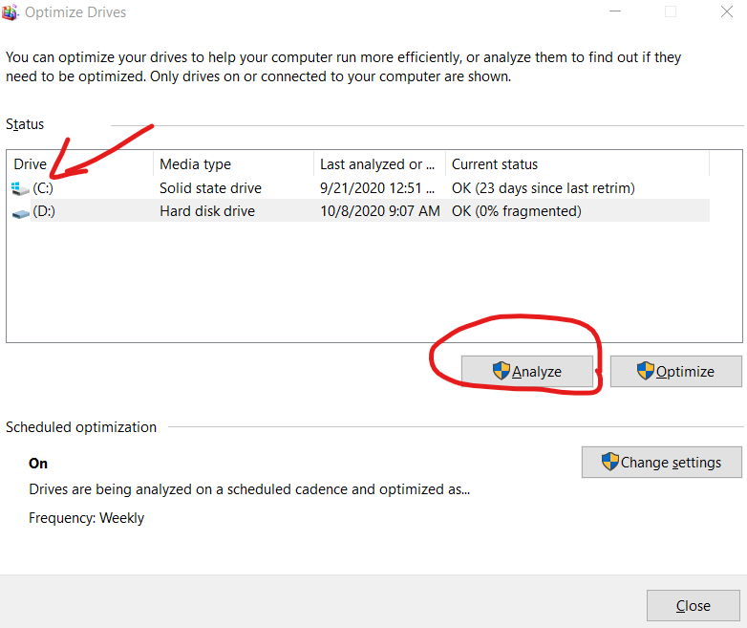
Analyze your drive
Click the drive that you use the most. If there is more than one that is, some computers only have one
After selecting your drive, click the “Analyze” button, and wait for the drive to be analyzed.

Slide 4
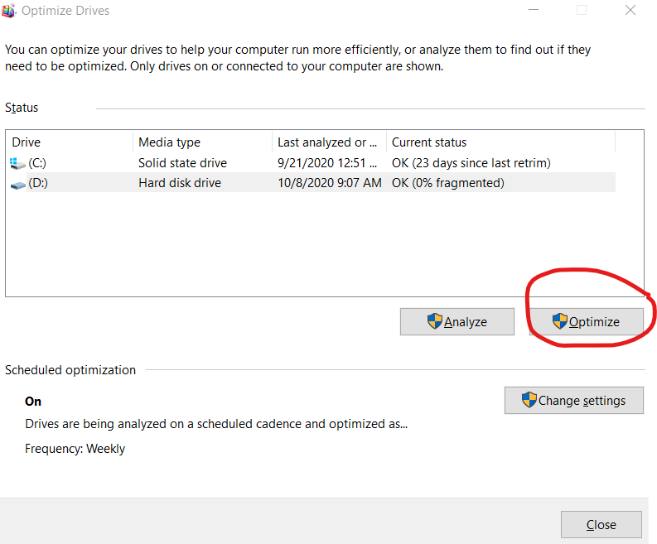
Run the defragmenter
After your drive has been analyzed, it will give you a percentage on how fragmented it is.
If the number is 0, great! Ordinarily you won’t need to optimize it at 0%, but we will do it just in case.
Now, click the “Optimize” button and allow that to run. Depending on how fragmented the drive is, this process may be quick or long.
After this is done, repeat for any other drives you may have. However, some drives cannot be optimized, so they should be left alone. These drives are called Solid State Drives (SSDs for short).
You can see your drive type under the Media Type column.

